Slide 1
Ebooks in the Academy: Transforming and/or Alarming?
Beth Mark, Beth Transue
Mike Cosby, John Fea, David Pettegrew,
Gene Rohrbaugh, Valerie Smith
Sponsored by Murray Library

Slide 2
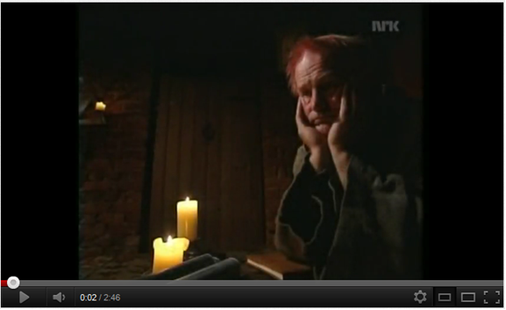
This isn’t new!
http://www.youtube.com/watch?v=pQHX-SjgQvQ

Slide 3
History
1971 – Project Guttenberg – manually typed print book text to create ebooks
(Declaration of Independence)
1993 – National Academy Press – publish some books in digital format. Free of charge. Sales increased.
1995 – Amazon launched. Started with excerpts and reviews

Slide 4
History
2001 – Wikipedia. Free online cooperative encyclopedia.
2006 – Google Books. Full text of public domain or with permission. Excerpts or citation only from other books. Most books digitized through participating libraries.
2007-current – ereaders, ipad.

Slide 5
Ebooks and Academic Study
What does the research say?
There is currently a usability divide between ebooks for leisure/linear reading, and for academic/non-linear reading.
After using ebooks, about 75% still prefer print for academic use.

Slide 6
Pilot Studies
Princeton, U of AZ, NW MO
Liked: Portability, Storage, Costs, Dictionary, Links and Multimedia Features
Disliked: highlighting, annotating, skimming, flipping back and forth through book, using multiple sources at once

Slide 7
Pilot Studies
University of WA
Less than 40% of students still used ereaders by the end of term
Cognitive mapping: students complained that they couldn’t use physical cues of book (location) to help memory, recall, and learning new material

Slide 8
Comparing Print to Ebook
Abilene Christian University
Compared comprehension and learning transfer (application) in college students reading print or etext on ipad
Comparable results for comprehension. Significantly better results for learning transfer with etext.

Slide 9
Comparing print to ebook
University of Western Ontario
Students instructed to find identical piece of information in identical academic print and ebook
In print, students used linear and logical process to find information.
TOC, index, keywords, alternate words, scanning page

Slide 10
Comparing Print to Ebook
In ebook, students were non-linear and there was no logical process to find information.
Unaware of TOC or index. Poor searches.
When scanning, missed seeing relevant information more often than in print
No sense of place. Mentioned they felt “lost” in the book

Slide 11
Faculty Panel
Gene Rohrbaugh
Valerie Smith
David Pettegrew
Mike Cosby
John Fea

Slide 12
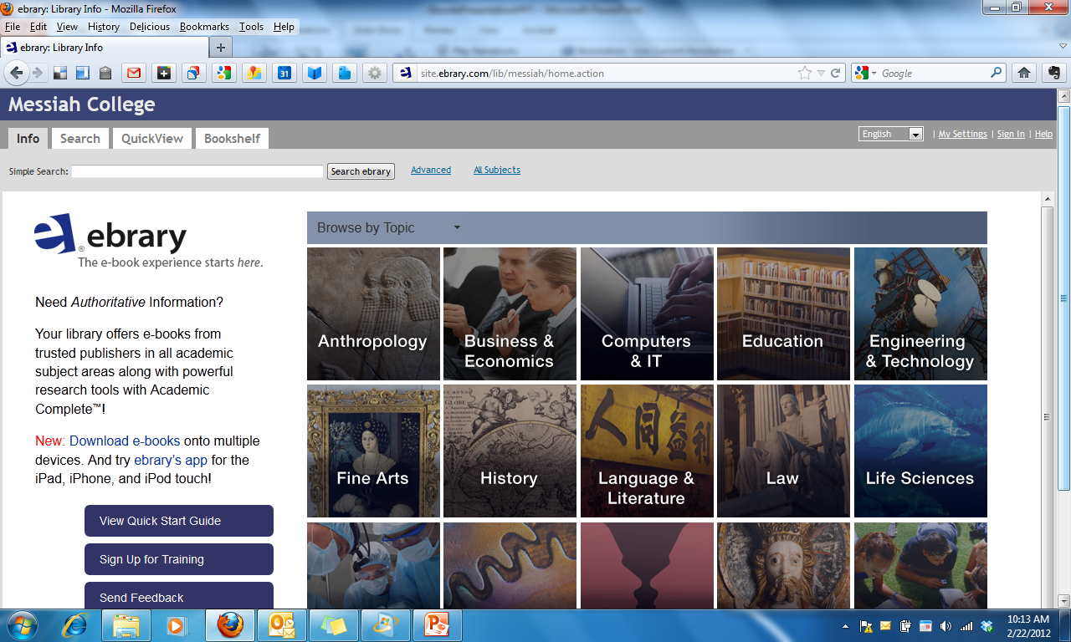
Ebooks at Messiah

Slide 13
Library and Faculty Concerns
No course reserves.
Will students/faculty request ILL of print book when we have ebook?
Revocable collection, cost.
Ordering becomes more complex. Need faculty input.

Slide 14
Messiah Student Perspective
Swinging Bridge article, October 2010
“For novels, reference works, and all kinds of classic literature, e-readers are great…..

Slide 15
….When I read non-fiction such as philosophy or theology, however, I need to look ahead. I need to be able to quickly flip pages so that I can see the layout of the argument. Then, when I begin to read from the beginning, my mind fills in the gaps. My comprehension is improved and I'm less likely to get lost among the trees while walking through the forest.”

Slide 16
Future developments
http://www.physorg.com/news/2012-01-smart-e-book-convenient-paper-based.html

Slide 17
Conclusion
Enormous potential!
Portability, storage, ADA, multimedia links, supplements, social
But there are also serious obstacles.

Slide 18
Sources
Berg, S., Hoffmann, K., & Dawson, D. (2010). Not on the same page: Undergraduates' information retrieval in electronic and print books. Journal Of Academic Librarianship, 36(6), 518-525.
BISG. (2011). College students want their books the old-fashioned way: in print. Retrieved from: http://www.bisg.org/news-5-603-press-releasecollege-students-want-their-textbooks-the-old-fashioned-way-in-print.php
Brown, T. (October 27, 2010). My new Kindle. Swinging Bridge. Retrieved from: http://www.messiahsb.com/my-new-kindle-1.2431877#.TzQ3RIGGs7A
Demski, J. (2010). The device versus the book. Campus Technology. Retrieved from: http://campustechnology.com/articles/2010/05/01/the-device-versus-the-book.aspx

Slide 19
Sources
Graydon, B., Urbach-Buholz, B., & Cohen, C. (2011). A study of four textbook distribution models. Educause Quarterly. 34(4). Retrieved from: http://www.educause.edu/EDUCAUSE+Quarterly/EDUCAUSEQuarterlyMagazineVolum/AStudyofFourTextbookDistributi/242784
Gertner, RT. (2011). The effects of multimedia technology on learning. (Unpublished master’s thesis). Abilene Christian University. Retrieved from: http://www.acu.edu/technology/mobilelearning/documents/research/effects-of-technology-on-learning.pdf
Hickey, H. (2011). College students’ use of KindleDX points to ereader’s role in academia. University of Washington. Retrieved from: http://www.washington.edu/news/articles/college-students2019-use-of-kindle-dx-points-to-e-reader2019s-role-in-academia
Lebert, M. (2009). A short history of e-books. Retrieved from http://www.etudes-francaises.net/dossiers/ebookEN.pdf

