Slide 1
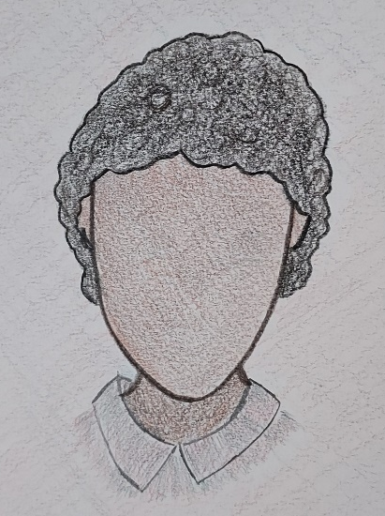
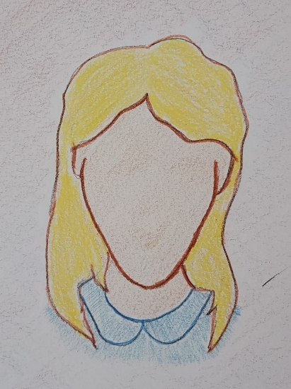
Examining the Lived Experience of Disabilities through Gender and Race
2024 Humanities Symposium
We The People: The American Project
Messiah University
Notes:
Melinda

Slide 2
Presenters
Melinda Burchard, Ph.D., Professor of Special Education
Sarah Myers, M.S.L.S., Public Services Librarian, Murray Library
Mila Acosta-Morales (2027)
Mireliz Bermudez (2025)
Grace Rhinehart (2025)
Maddie Unger (2025)
Direct questions to: mburchard@messiah.edu or smyers@messiah.edu
Notes:
All

Slide 3
Key Citations
Each of these texts informs this presentation. Additional citations on specific slides.
Barton, P.E., and Coley, R.J. (2009). Parsing the Achievement Gap II. Educational Testing Service. www.ets.org/research/pic
Elder, T.E., Figlio, D., Imberman, S., and Persico, C. (2021). Segregation and racial gaps in special education: New evidence on the debate over disproportionality. Education Next , 21(2), 62-68. https://www.educationnext.org/segregation-racial-gaps-special-education-new-evidence-on-debate-over-disproportionality/
Hardwick, L. (2024). How Ableism Fuels Racism: Dismantling the Hierarchy of Bodies in the Church. Ada, Michigan: Brazos Press. (released Feb 20, 2024, available in Murray Library)
Harry, B., and Klingner, J. (2022). Why Are So Many Students of Color in Special Education?: Understanding Race and Disability in Schools. New York: Teachers College Press.
Notes:
Melinda

Slide 4
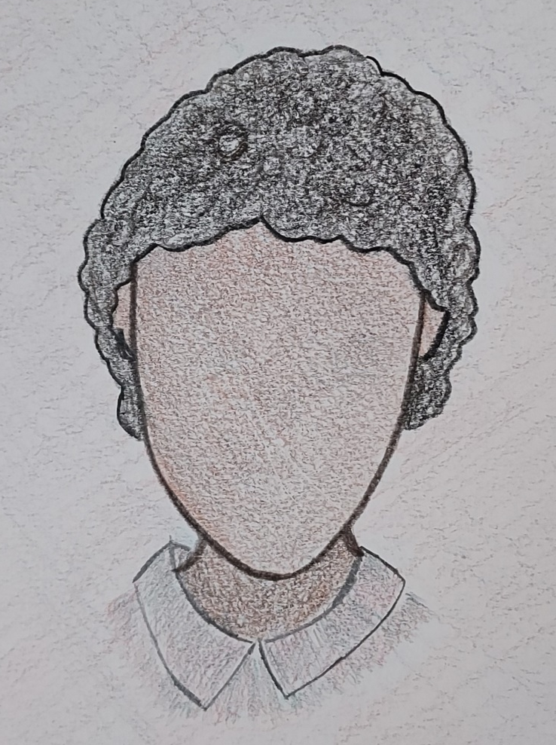
Our approach: some events/ facts followed by imagination of possible lived experiences of two example children across a timeline
1770
1800s
1954
1966
1976
1991
2000
2024
BOTH
Age ten
Living in PA
Specific learning disability in reading
ADHD: executive functioning, memory, self-regulation
Notes:
Melinda

Slide 5
1760 to 1895– Carlisle Iron Works, Boiling Springs, PA
1770
1800s
1954
1966
1976
1991
2000
2024
Gertner, L., Moor, C.G., and Pfingsten, B. (February 20, 2023). The iron industry in Boiling Springs. The Historical Marker Database. https://www.hmdb.org/m.asp?m=202192
Walker, J. E. (1969). Negro Labor in the Charcoal Iron Industry of Southeastern Pennsylvania. In The Pennsylvania magazine of history and biography, 93(4), 466–486. https://messiah.primo.exlibrisgroup.com/permalink/01MESSIAH_INST/74pisc/cdi_proquest_journals_1301498371
Notes:
Sarah
Industrialization included extensive timber harvesting, iron production, water power.
Families who were black working at the Iron Forge may have been indentured workers, or were at least experiencing financial limitations. Multiple generations usually shared one very small tenant house.
John might have lived in a tenant house.
Tenant houses were located in an area close to the iron forge, typically downwind of the forge.
Children of tenants did not typically attend school, and might join adults in iron forge work by John’s age of ten. The work was very labor intensive.
Elizabeth might have lived in the Iron Master’s house or in the town.
Homes in the town were located in the area typically upwind of the forge.
Girls would typically attend schools run by a local church or minister, or receive private tutoring. By Elizabeth’s age of ten, she might not be continuing in school due to her academic struggles. Her training would likely have shifted to homemaking skills, or home industry.

Slide 6
1834 – PA Free School Act 1881 – Desegregation of PA Public Schools
1770
1800s
1954
1966
1976
1991
2000
2024
Davidson, L. (n.d.). Desegregation of Pennsylvania schools. NW PA Heritage. Retrieved February 6, 2024, from https://nwpaheritage.org/items/show/98
Mader, S. (2016). Carlisle public schools: Segregation to integration. Gardner Library. Retrieved February 6, 2024, from https://gardnerlibrary.org/encylopedia/carlisle-public-schools-segregation-integration
Wickersham, J. P. (1885). A history of education in Pennsylvania. Arno Press. https://catalog.hathitrust.org/Record/100607524/Home
WITF. (2023). "The Surest Foundation of Happiness ”: Education in Pennsylvania .” Stories from PA history. Retrieved February 6, 2024, from https://explorepahistory.com/story.php?storyId=1-9-21
Notes:
Sarah
In the 1800s, public education as a public good to educate America’s next generation of citizens became an important crusade. The state government, along with Thaddeus Stevens, pushed for tax-supported public schools within each county. In most counties, there were local school houses for boys and girls and one school house available in each county for African Americans. Teachers were not formally or well trained. Teachers were under no obligation to educate those with intellectual disabilities or ADHD. There were some schools around the state for those with physical impairments like schools for the blind or deaf, but these were rare and typically were racially limited to white children.
John may have gone to a public school house for African American children, but it likely would have been inconvenient to his rural location and the teachers would likely have been frustrated with his abilities. He would have had more success working and contributing to his family’s income.
Elizabeth would have had the local option to attend school for as much or as long as she would have liked. There were strict expectations to pass into the next grade, and if they weren’t met, Elizabeth would have remained in the same grade.
Schools were legally desegregated in PA in 1881 through a court case, but we know racial segregation in elementary school continued in nearby Carlisle until 1948. Separate and unequal educations persisted for students.
Industry was changing in PA throughout the century. Less emphasis on agriculture and more on transportation or factory production. John’s parents may have moved to find work in railroads, factories, or public utilities companies.

Slide 7
1954– Supreme Court ruling, Brown v. Board of Education
1770
1800s
1954
1966
1976
1991
2000
2024
Pruitt, S. (September 7, 2023). Brown v. Board of Education: The first step in the desegregation of America’s schools. History.com. https://www.history.com/news/brown-v-board-of-education-the-first-step-in-the-desegregation-of-americas-schools
Notes:
Mimi
In 1954,– Brown v. Board of Education– the Supreme Court ruled that Kansas laws that separated schools by race were unconstitutional, and that all children had right to learn without prejudice. This applied federally, but state and local responses varied from action to inaction to open resistance.
In 1954, John would have attended a school for children who are black.
Most of the teachers at his school may not have been certified, though some would be.
He was not likely identified as having a disability, but would instead have been considered a “slow learner”.
His school was imagining the realities of the process of integration.
Meanwhile, Elizabeth would have been attending a school for children who were white.
Her teachers were all certified elementary teachers.
She too would not have been identified as having a disability, and would also have been considered a “slow learner”.
Her school would likely have been considering how to resist the process of integration.

Slide 8
1966– Elementary and Secondary Education Act, Grade Leveling
1770
1800s
1954
1966
1976
1991
2000
2024
Darling-Hammond, L. (1998). Unequal opportunity: Race and education. The Brookings Review, 16(2), 28–32. https://doi.org/10.2307/20080779
Kohli, R., Pizarro, M., & Nevárez, A. (2017). The “New Racism” of K-12 schools: Centering critical research on racism. Review of Research in Education, 41(1), 182–202. https://doi.org/10.3102/0091732X16686949
Notes:
Mimi
Educational Regulations caught up with Brown V. Board of Education with the passage of Federal Education legislation of the The Elementary and Secondary Education Act in 1965.
As schools became integrated, a new practice has become the norm, leveling within grades. In secondary grades, courses might be designated college prep or honors. At elementary grades, such leveling typically looked like classes being labeled as 4A, 4B, 4C, etc. The most experienced and talented teachers were typically assigned to A levels, and children were assigned subjectively.
By 1966, then, John would likely have been attending the same school as Elizabeth.
John would not yet have been identified as having a disability, still considered a “slow learner”.
He would likely have been served in the C group for his grade with most others in the C group also black children, and with the least qualified teacher.
While Elizabeth would be attending the same school as John, her experience was likely quite different.
Elizabeth is also not yet served in any way for a learning disability, but her parents might be learning about this new term.
Because of the subjective system of leveling, Elizabeth would likely have been served in the B group for her grade. Most others in the B group are also white children.

Slide 9
Education for All Handicapped Children Act (1975)
1770
1800s
1954
1966
1976
1991
2000
2024
Dalien, L. (2022). The history of special education. Special Ed Resource.com. https://specialedresource.com/history-special-education
Notes:
Mila
The first version of what we now know as IDEA, the Individuals with Disabilities Education Act, was originally known as Public Law 94-142. That passed in 1975 as a Special Education entitlement act.
That law established categories of eligibility, including Specific Learning Disabilities and Other Health Impaired.
Students fitting those eligibility categories now had a right to a “Free Appropriate Public Education” in the “Least Restrictive Environment” possible.
Imagine it’s now 1976.
John’s family has now likely moved to the East Shore.
If John was identified as having a disability, he would likely have been mis-identified as having an intellectual disability.
Students of color (especially black boys) identified with disabilities experienced less inclusion– some call “legal segregation”, so John would have likely been served in a Special Education setting more than half of the school day, or possibly for all of his school day.
Elizabeth’s family has by this time likely moved to the West Shore.
Elizabeth may have been identified with a reading learning disability.
She would likely have been served in Special Education for reading, but less than half of her school day.

Slide 10
1770
1800s
1954
1966
1976
1991
2000
2024
1991– poor inclusion of students with disabilities
Gaskin v. Commonwealth. Public Interest Law Center. https://pubintlaw.org/cases-and-projects/gaskin-v-commonwealth/
Notes:
Mila
According to the Public Interest Law Center, “In the early 1990s, Pennsylvania had the second worst rate of inclusion of students with disabilities in regular education classrooms in the country – and when students were included, it was often without real support.”
John would still likely be served in special education in the category of intellectual disability.
He would have likely been served about 80% of his school day in special education. He might have been with non-disabled peers for lunch, physical education, art and music.
ADHD is still undiagnosed in this timing. Jon’s struggles with self-regulation may have resulted in some discipline and history of a few suspensions.
Elizabeth would likely now have been eligible for special education in the category of specific learning disability.
She would have encountered a less restrictive environment, likely served about 50% of the school day in special education for reading, writing, and social studies. She would then have been with her non-disabled peers for math, science, and more.
Though her ADHD would also not yet have been diagnosed, because of her gender and culture, her struggles with self-regulation would have NOT resulted in suspensions, but instead in frequent in-class corrections, parent communications, and repeated directions for academics.

Slide 11
1770
1800s
1954
1966
1976
1991
2000
2024
After Gaskins v Commonwealth (1994)
Gaskin v. Commonwealth. Public Interest Law Center. https://pubintlaw.org/cases-and-projects/gaskin-v-commonwealth/
Elder, T.E., Figlio, D., Imberman, S., and Persico, C. (2021). Segregation and racial gaps in special education: New evidence on the debate over disproportionality. Education Next, 21(2), 62-68. https://www.educationnext.org/segregation-racial-gaps-special-education-new-evidence-on-debate-over-disproportionality/
Notes:
Grace
So The 1994 Gaskins case forced PA schools to practice inclusion, decreasing number of children with disabilities served primarily in special education, increasing percentage of time served with non-disabled peers. That case also required authentic supports for inclusion to work, including such practices as co-teaching.
Now imagine it’s the year 2000, six years after the Gaskins case.
By this time, John would have been found eligible in two categories, specific learning disability for reading and in Other Health Impaired for his ADHD.
He might have been served about 40% of the school day in special education for reading interventions and behavior support.
He may have still experienced some discipline related to his ADHD, but no extended suspensions. Pennsylvania is now being more careful with their discipline procedures involving children with disabilities, including a stronger Manifestation Determination process.
While Elizabeth would also be found eligible in the same categories of specific learning disability and Other Health Impaired for her ADHD, her percentage of service would likely have differed.
In a better funded public school, she may have been educated part of her day with a co-teaching model, meaning she could be served maybe around 20% of the school day in a special education setting, and another 10 to 20% of her school day in the regular education setting with co-teaching model for support. With co-teaching, she would have been with non-disabled peers for most content.

Slide 12
2016 to 2024 -- Fair Funding for Public Schools in PA
1770
1800s
1954
1966
1976
1991
2000
2024
Commonwealth of Pennsylvania Basic Education Funding Commission. (January 11, 2024). Majority report adopted by commission: Basic Education Funding Commission report and recommendations. https://basiceducationfundingcommission.com/
Education Law Center. (2023). Money matters: Evidence supporting greater investment in PK-12 public education. https://pubintlaw.org/
Moon, K. (2016). Education funding in Pennsylvania: Inadequate, inequitable, and unconstitutional. The Public Interest Law Center: Education Law Center. https://pubintlaw.org/
Notes:
Maddie
Special Education has never been fully funded.
Compounding that problem, in PA, we currently have considerable discrepancies in funding of public schools, with most funding in each district coming from property taxes in the district neighborhoods
In 2016, we saw the PA Fair Funding formula, House Bill 1552 (Act 35 of 2016) In 2020, the pandemic revealed significant differences in access to reliable home internet In 2023– a PA Commonwealth court ruled that PA’s distribution of school funds was unconstitutional, requiring a report and action, but there was no required timeline or consequences for delayed action. In January 2024– the Basic Education Funding Commission adopted a recommended blueprint for PA school funding, but that still needs to progress through PA’s House and Senate for approval.
Economic and racial segregation of neighborhoods continues.
Since most of school district budgets are funded by property taxes, until that is addressed, students will experience education differently according to their neighborhood.
The Fair Funding Plan proposes to better share the wealth with economically disadvantaged school districts and schools.
MEANWHILE
The population of John’s neighborhood has about 90% students of color.
About 80% of students receive free and reduced lunches.
John has an IEP for a learning disability and ADHD, and is receiving special education interventions 30% of the day specifically for reading and self-regulation.
The population of Elizabeth’s neighborhood has about 30% students of color.
About 40% of students receive free and reduced lunches.
Elizabeth has an IEP for a learning disability and ADHD, and is receiving special education interventions in the special education setting 10% of the day and co-teaching support in the regular education setting 20% more of the day.
Disparities in special education continue by gender and especially by race.
That leads us to invite you to IMAGINE with us, something better for the future of special education in PA.

Slide 13
ONE FRAMEWORK to help us IMAGINE Something Better
Identity
Diversity
Justice
Activism
IDENTITY: grow in awareness of lenses and biases.
DIVERSITY: show appreciation for diversity of ALL in a community and welcome diverse perspectives.
JUSTICE: notice injustice, disparities, racism, ableism, etc.
ACTIVISM: take specific actions to address injustice, disparities, racism, ableism, etc.
Van der Valk, A. (Summer 2014). Identity. Diversity. Justice. Activism. Introducing the Teaching Tolerance Social Justice Standards. Learning for Justice. Issue 47. https://www.learningforjustice.org/magazine/summer-2014/identity-diversity-justice-action
Notes:
Melinda explain this framework

Slide 14
BRIEFLY REFLECT/ SHARE
Identity
Diversity
Justice
Activism
IDENTITY: Think privately about YOUR own perspectives, lenses and biases. How do those inform YOUR thoughts about how disability intersects with race and even gender in schools?
DIVERSITY: Think then Share with those sitting near you. From your own past, how have events or experiences contributed to your appreciation for diversity in your community or how have you observed an experience that welcomed diverse perspectives?
Van der Valk, A. (Summer 2014). Identity. Diversity. Justice. Activism. Introducing the Teaching Tolerance Social Justice Standards. Learning for Justice. Issue 47. https://www.learningforjustice.org/magazine/summer-2014/identity-diversity-justice-action
Notes:
Grace, Maddie
Invite folks to reflect on identity
Invite folks to think then share about diversity
– ALL supporting

Slide 15
Collaborate to IMAGINE Something Better
Identity
Diversity
Justice
Activism
JUSTICE: notice injustice, disparities, racism, ableism, etc.
ACTIVISM: take specific actions to address injustice, disparities, racism, ableism, etc.
With that same small group, CHOOSE EITHER Justice or Activism. Discuss specific actions within your sphere of influence.
From that discussion, WRITE KEY WORDS or ILLUSTRATE a KEY IDEA.
Van der Valk, A. (Summer 2014). Identity. Diversity. Justice. Activism. Introducing the Teaching Tolerance Social Justice Standards. Learning for Justice. Issue 47. https://www.learningforjustice.org/magazine/summer-2014/identity-diversity-justice-action
Notes:
Sarah prompting
All supporting

Slide 16
Let’s DISCUSS our visions for the future
Notes:
Sarah invite groups to share with nearby groups.
Invite just a few to share out.
Thank participants

